Slide 1
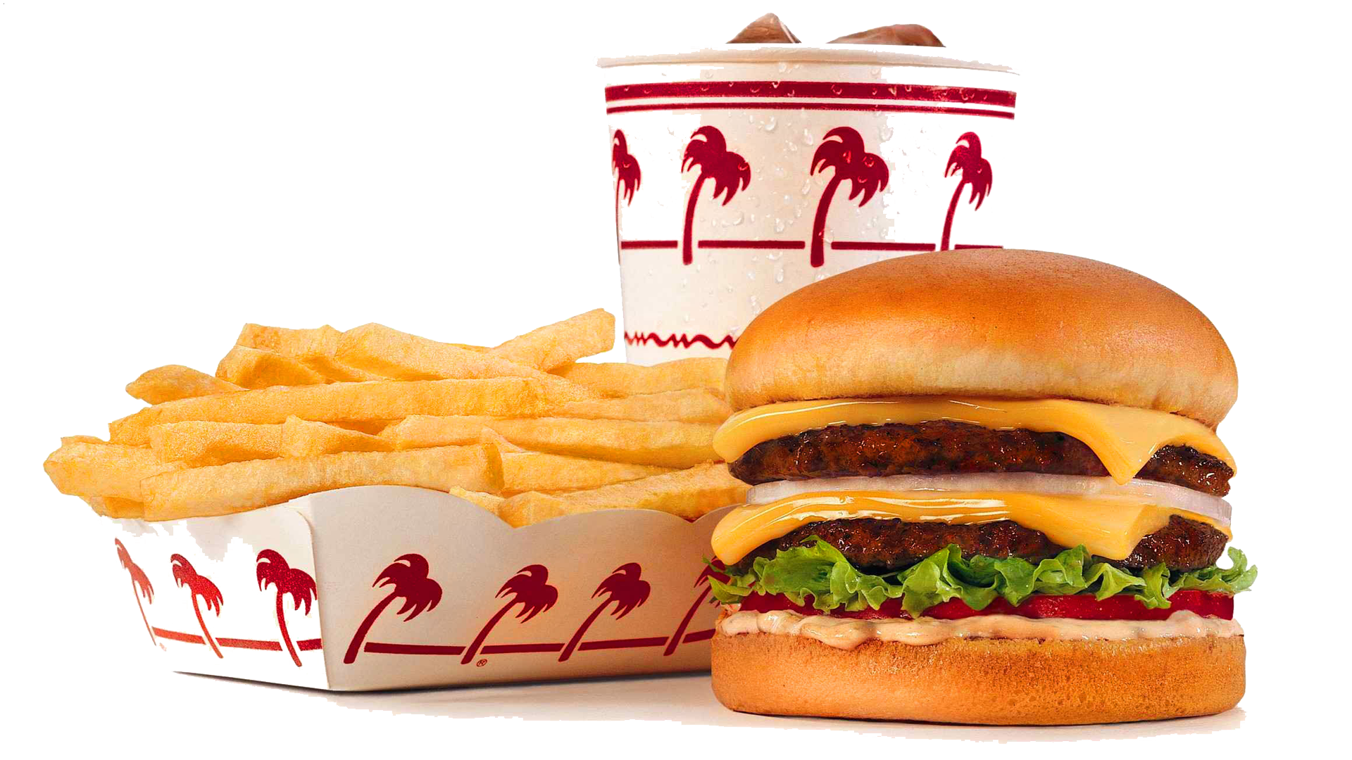
Zomato- Food Delivery Analysis & Recommendation model
ML- group- 8
Tools used- Python, SQL, Excel
This Photo by Unknown Author is licensed under CC BY-NC

Slide 2
Our Team -:
Naman Sharma (PD16_102)
Raj Tripathi (PD16_249)
Anmol Srivastav (PD16_293)
Nikunja Barman (PD15_221)

Slide 3
Project Details-
Phase 1
Phase 2
Scrape data from food delivery platform Zomato and do the analysis of restaurants across city of Bangalore for different locations and for different cuisines and generate insights and finally make a dashboard out of it.
Build a recommendation model for someone who wants to open a restaurant in Bangalore. The model should take cuisine and location as an input, give some preferred outputs per user need, and recommend a price for cuisine.

Slide 4
Steps involved-
Understanding the objective.
Web Scraping the data from Zomato – where we faced a few challenges.
Pre-processing of the raw data to make it clean and ready for analysis.
Data analysis on Excel and SQL- generating insights from the raw data.
Data Visualization and creating a dashboard using the insights generated.
Building a python input-output model for users.
Building Machine Learning models for the recommendation of prices for a certain cuisine at a certain location.

Slide 5
Insights -: 1)Location wise restaurants distribution , 2)Number of restaurants with delivery reviews>1000 location-wise.

Slide 6
3) Sum of delivery reviews location wise, 4) Cuisine-wise number of restaurants.

Slide 7
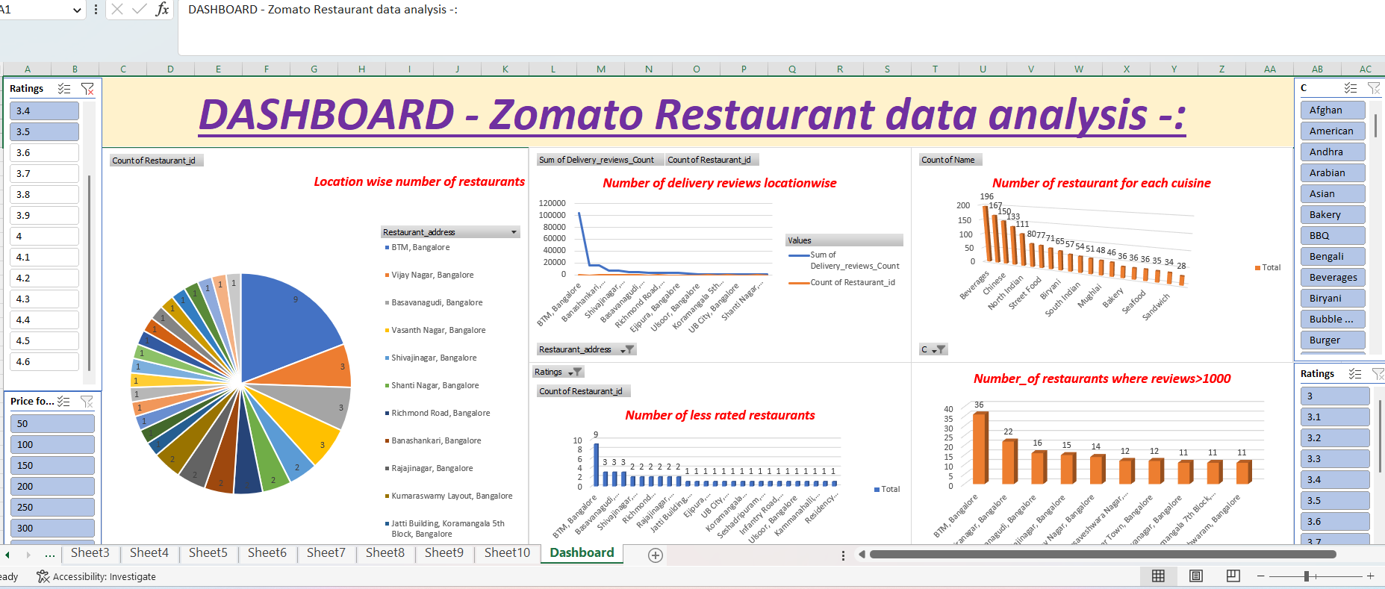
5) Number of less-rated restaurants location wise – (with ratings less than 3.5)

Slide 8
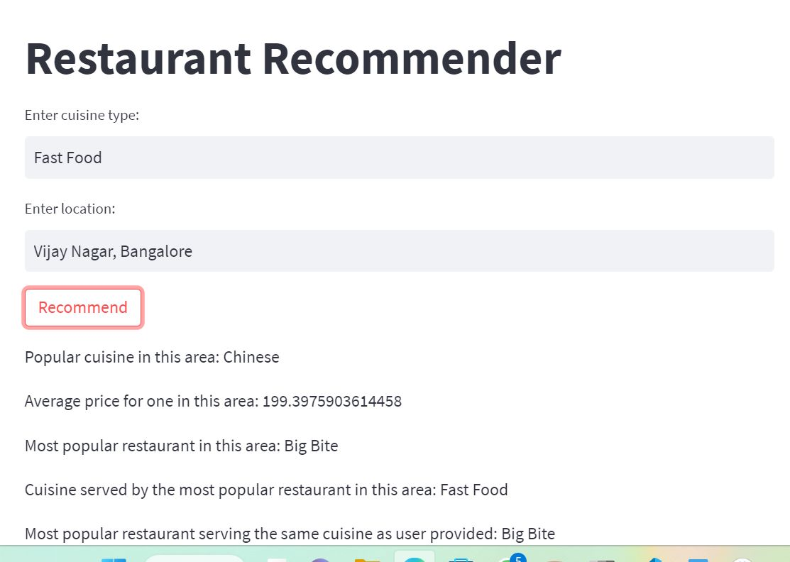
Recommendation –model -
This model will take cuisine and location as an input from an user and by using the data it will return user outputs like-
Popular cuisine at that location
Average price at that location
Most popular restaurant at that location
Cuisine served by most popular restaurant
Most popular restaurant serving same cuisine which user provided.

Slide 9
Challenges & Learnings-
Challenges-
1) Web scrapping from Zomato was very difficult because Zomato is a very anti-scrapping website.
2) Building an input-output-based recommendation model using python was a very new and tough task.
3) Trying different machine learning models with different techniques to get a high-accuracy model was very time-consuming.
Learnings-
1) Learnt how to automate a process using selenium and how to scrape data using beautifulsoup module of python.
2) How to generate insights from raw data.
3) How to build a recommendation-model (input-output based using python) & ( a machine learning model for price prediction).

Slide 10
Thank you
Have a nice day

